Slide 1

Advancing Academic Quality Through An Innovative Model of Shared Leadership
Rose Marie Kuceyeski, Ph.D.
Gretchen K. Carroll, J.D.,M.B.A.

Slide 2
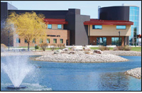

WHAT IS OWENS COMMUNITY COLLEGE ?
Comprehensive public community
college in Northwest, Ohio
Over 22,000 students
Three campuses (Urban, Rural & Suburban)

Slide 3
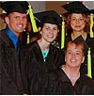
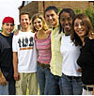
WHAT IS OWENS COMMUNITY COLLEGE ?
Experienced rapid enrollment growth over the last ten years
Moved from a centralized to decentralized administration
PEAQ accreditation

Slide 4
WHAT IS OWENS COMMUNITY COLLEGE ?
SYMPTOMS OF A PROBLEM
Perceived lack of trust
Communication issues
Dysfunctional decision-making
Few risk takers
Accreditation fog

Slide 5
WHAT IS OWENS COMMUNITY COLLEGE ?
SYMPTOMS OF A PROBLEM
Dysfunctional committee structure
Lack of accountability
Institutional issues solved by a few people
Institutional culture change

Slide 6

WHERE DID WE START ?
Met with key employee groups
Group consensus on need for change
Agreed to “pilot” a process management program
Applied for AQIP

Slide 7
PRELIMINARY RESULTS
Involved all employee groups
Highest involvement in accreditation activities in college history
Some long-standing problems were actually solved !!!!!!!!!

Slide 8
NOW WHAT ????????
ALL RIGHT
THERE MIGHT BE SOMETHING HERE,
NOW WHAT ?????

Slide 9
A MISSING COMPONENT
We still needed to change the culture of the institution to provide a foundation for AQIP and continuous improvement.
We also needed a model that could help us navigate three very important initiatives.

Slide 10
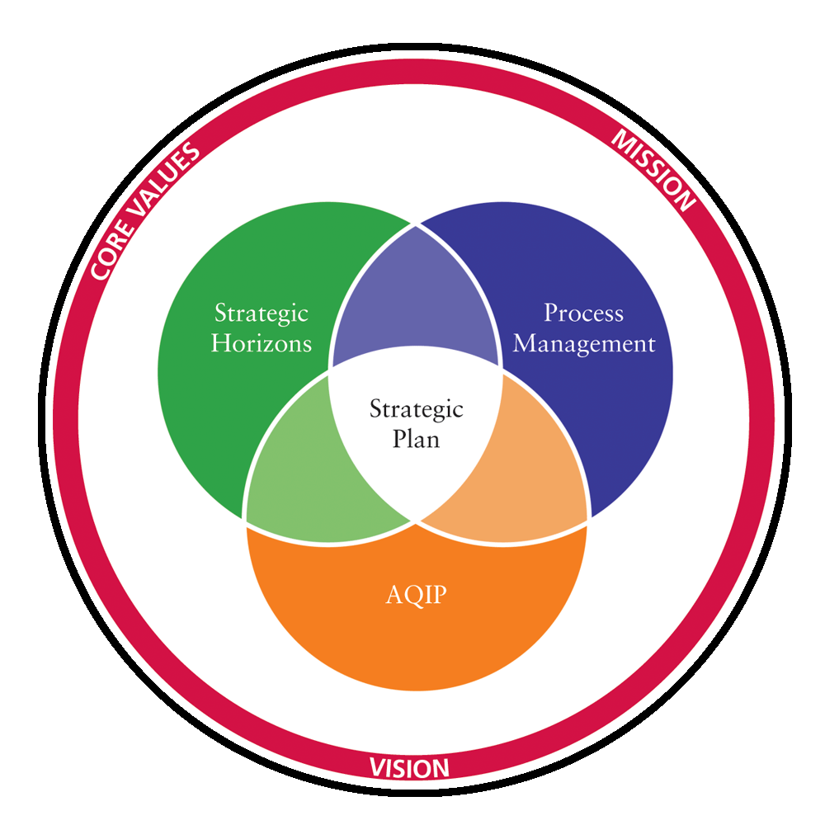

Slide 11
Although we’d made tremendous progress with all of these initiatives we didn’t have a formalized leadership model that linked them all together.
So, the President empanelled a team to research leadership models that might be applicable to OCC.

Slide 12
THE TEAM’S CONCLUSION?
Because of the driving forces of change in the 21st century, and our unique situation with AQIP, SHN, and Process Management, none of the traditional models as described by Birnbaum, or other scholars, were applicable to OCC.
Create a collaborative leadership model unique to OCC.

Slide 13
THE RECOMMENDATION?
Create and adopt a pluralistic and adaptive leadership model.

Slide 14
ADAPTIVE LEADERSHIP
A framework for attaining employee commitment to actively participate in the adaptive challenges and decision-making process of the college. Requires people to do their part and take responsibility.
Adaptive decisions are non-technical and not routine: reengineering, restructuring, quality programs, strategic change, cultural change, crisis, persistent conflict.
"Adaptive leadership requires an experimental mindset rather than an 'I've got the answers' mindset.”
Heifetz, et al. (2004). Dimensions of adaptive leadership.
Randall, L. M., & Coakley, L. A. (2007). Applying adaptive leadership to successful change initiatives in academia. Leadership & Organization Development Journal, 28(4), 325-335.

Slide 15
PLURALISTIC LEADERSHIP
A new leadership framework for thinking about the role of leaders, the various perspectives of diverse leaders, and the leadership process at the institution
Pluralistic cultures draw on the collective diverse voices of all the stakeholders (e.g., students, full and part-time faculty, full and part-time staff, administrators, business/industry, community partners, alumni, board members) and includes these major stakeholders in the adaptive decision making process.
Kezar, A., (2000), Pluralistic leadership incorporating diverse voices. The Journal of Higher Education, 71/6.

Slide 16
“ONWARD- HO”
A faculty facilitator, from the School of Business, was given release time to move the project forward.
The facilitator researched successful organizational change and leadership models and decided to follow the advice of organizational change expert, John Kotter.

Slide 17
KOTTER’S 8 STEP CHANGE PROCESS
1. Create a Sense of Urgency.
2. Pull Together the Guiding Team.
3. Develop the Change Vision and Strategy.
4. Communicate for Understanding and Buy-in.
5. Empower Others to Act.
6. Produce Short-Term Wins.
7. Don’t Let Up.
8. Create a New Culture.

Slide 18
SO, WE PUT TOGETHER A GUIDING COALITION…
that met weekly for 9 months….
worked diligently…..
interacted respectfully….
created a collaborative leadership model….
that was uniquely our own….

Slide 19
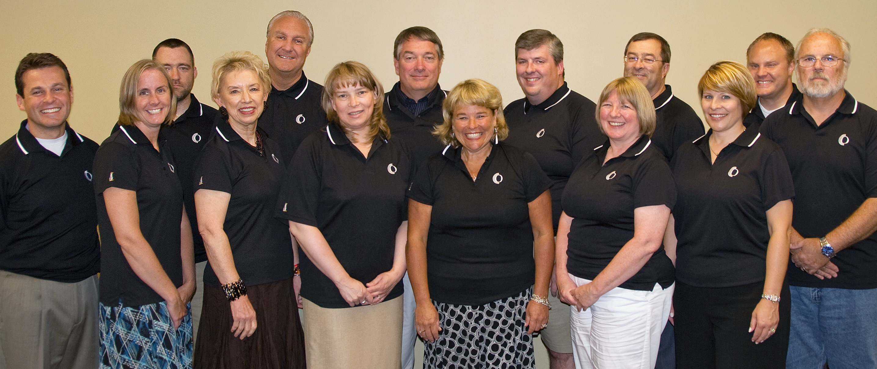

THE GUIDING COALITION
SETTING THE STAGE FOR CHANGE
Our Coalition was a pluralistic representation of faculty,
staff, administrators and a trustee. We agreed
“not to tackle someone wearing the
same color jersey.”
Notes:
19
A Team was Formed
(Graphic – Team Photo)
A team of volunteers representing all employee groups was formed last January.
This team was called the Guiding Coalition.
Members, please stand when I call your name, and remain standing:
Paul Adams
Bruce Busby
Gary Corrigan
Judy Ennis
Cynthia Eschenburg
Betsy Johnson
Gene Lapko
Dave Matheny
Brian Paskvan
Tom Perin
Shelby Pierce
Karen Reed
John Satkowski
Mike Schmitz
Paul Unger
Verne Walker
Jason Zielinskii
Gretchen Carroll, Professor of Marketing/Management and Coordinator of the Owens Leadership Academy facilitated the Guiding Coalition.
Vice Chair Dee Talmage of the Board of Trustees participated in the Guiding Coalition meetings.

Slide 20
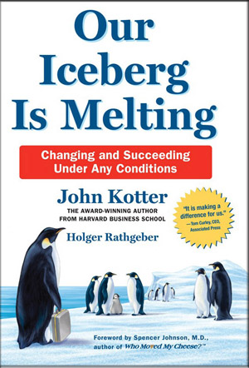

THE GUIDING COALITION
THE GUIDING COALITION SET THE STAGE FOR CHANGE BY BECOMING A COLONY OF PENGUINS THAT NEEDED TO FIND A NEW ICEBERG.
Notes:
20
“Our Iceberg is Melting”
The Team adapted Professor John Kotter’s process of how to bring about change, successfully, as illustrated in his book, Our Iceberg is Melting.
If you haven’t read this book yet, it’s about a colony of penguins who live on an iceberg that is melting. Concerned about this condition, a team of penguins explores ways to find a new home. If you’ve ever observed penguins, then you know that they are very predictable. Very resistant to change. But urgency prevailed because the colony’s very survival depended on change. So, they had to “decide what to do” and “make it happen.” Even then it wasn’t over, they had to “make it stick” by creating a new vision. And they did too. Not only did they find the perfect iceberg, but they envisioned something really innovative for penguins. They became nomads. By staying on the move, the penguins keep the momentum of change going.
At Owens, the guiding team explored ways to achieve collaborative leadership.
They got down to the root of the College’s traditional committee structure.
They looked back at what happened in the past, but they did not stare.
The team met weekly for seven months, and now they will present a
NEW VISION for the future based on TRUST, ACTION and ACCOUNTABILITY.

Slide 21

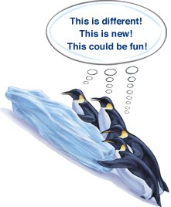

WE CREATED A SENSE OF URGENCY…
and changed our names to….Peter Professor, Fred, No-No, Louis, Buddy and Alice (the tough old bird and facilitator of the group)

Slide 22
WE ESTABLISHED TEAM NORMS, MISSION, & OBJECTIVES
Mission:
Develop an environment of collaborative leadership, based on trust, action and accountability.

Slide 23
GUIDING COALITION OBJECTIVES
Identify and meet the legitimate leadership needs of OCC.
Review the current decision making processes, and set standards for the future based upon collaboration, trust, action, and accountability.
Define and communicate the differences between adaptive and technical decisions, and identify appropriate stakeholder groups to be included in the decision making process.
Determine the composition of leadership teams and how they connect.
Have leadership teams in place by Fall 2008.

Slide 24
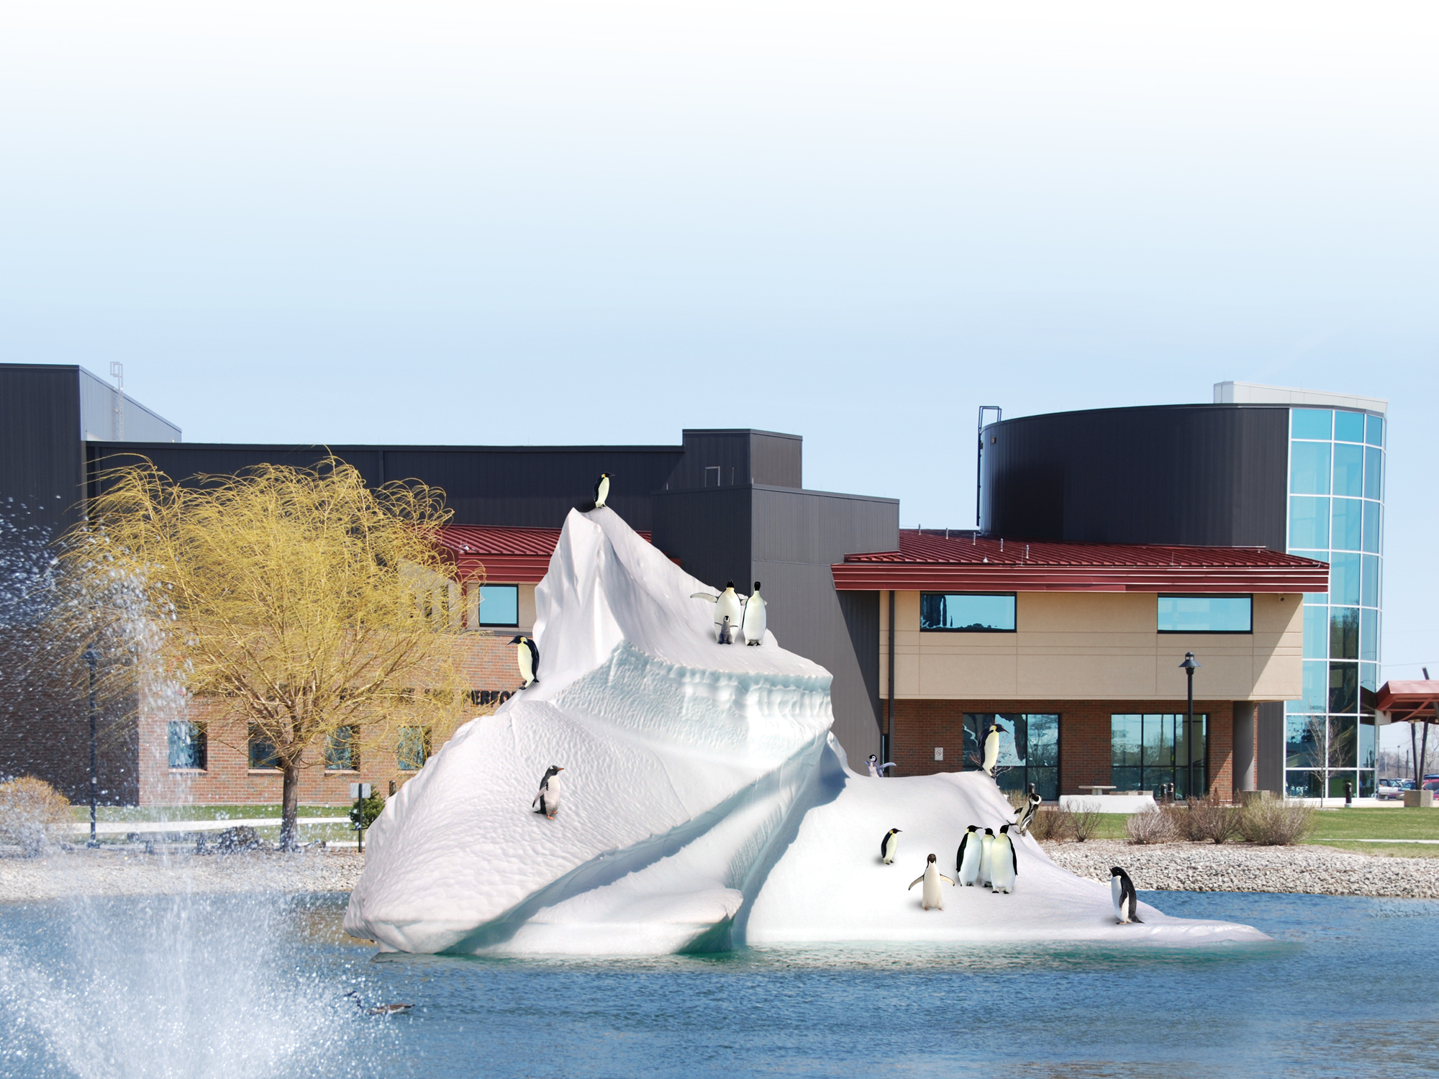
SHARED VS. COLLABORATIVE LEADERSHIP
We embraced the idea of shared leadership, rather than collaborative leadership, because we thought it was a term everyone could understand.

Slide 25
THE GUIDING COALITION
We set a vision of what shared leadership would mean to the college.
Owens will be a LEADER IN LEARNING.

Slide 26
WE LOOKED OUR INITIATVES & FOUND A COMMON LINK
We determined that our new iceberg of shared leadership needed be an inclusive habitat that encourages the participation of all stakeholders and embraces our Strategic Horizons, AQIP, and Process Management initiatives.
We also wanted to streamline our processes and eliminate any of the redundancies between the efforts.

Slide 27
THE COMMON LINK WE DISCOVERED?
Creating a culture of excellence driven by academic quality.
As an AQIP and SHN Institution we have to be focused on quality and shared leadership throughout the organization.
So we made AQIP and Quality the Umbrella of all of our efforts.

Slide 28
THE GUIDING COALITION
We drafted a mission statement for shared leadership that our campus community would understand. We needed to send a clear message that we all support academic quality and student success regardless of job position or title.
“Learning Is The Sum Of All That We Are!”
Notes:
28
Creating the Environment
Shared leadership needs an environment in which it can thrive.
We already have an essential ingredient in place.
It’s YOU. …A caring faculty and dedicated staff who create quality experiences for our students.
Student success is our mission. We know it. We do it. We are ALL part of it.
So, let’s do it with a winning attitude.
Our message of unity is ….
“Learning Is The Sum Of All That We Are!”
This message reflects the principles of AQIP, our Academic Quality Improvement Program, through which we achieve our accreditation with the Higher Learning Commission.
Quality will serve as the umbrella of our model of Shared Leadership.

Slide 29
THE SHARED LEADERSHIP MODEL
Facilitates communication among all members of the Owens Community College community and places authority for decision making with those who should be making the decisions.
It is a flattened model of circles, rather than ladders, that allows for the two-way flow of information and establishes a structure for decision making at the appropriate point of contact.

Slide 30
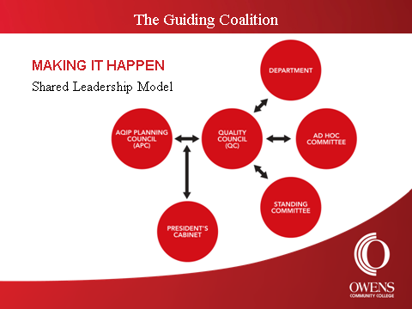

Slide 31
THE MODEL CONSISTS OF…
Two standing councils (the AQIP Planning Council and the Quality Council)
OCC Departments, Standing Committees and Ad Hoc Committees
College personnel (as individuals and groups) are also part of the leadership model- since this model recognizes that all members of the college community are leaders and that all members should have the opportunity to participate in the decision-making process.

Slide 32
APC and QUALITY COUNCIL
QC makes the strategic adaptive decisions,
AQIP action items and projects.
QC determines who shall act to implement the adaptive decisions made by APC.
The projects/initiatives will be assigned, along with a quality trainer, to either a standing committee; an ad hoc committee; a department, division, school, or individual.
QC is responsible for providing support to the assignee and will report back to APC the status of the project.

Slide 33
MEMBERS OF THE COUNCILS ARE…
Are either assigned to the council via position or elected from their stakeholder group including student representatives.
Both councils have elected positions that represent administration, chairs, the community, deans, faculty, adjunct faculty, and bargaining unit and non-bargaining unit staff.
There are also be two members at large, one from each of our campuses.

Slide 34
ELECTIONS ARE HELD ANNUALLY
Individuals interested in serving may self-nominate by application available on the intranet.
Procedures are in place for elections and replacement of council members.
Anyone at OCC may make a suggestion to the APC – the form is on the intranet.

Slide 35
THE LESSONS LEARNED?
Our President was instrumental - she supported the team, stayed out of the way, and empowered them to develop the model.
Trustee involvement was key- GC members felt like the trustees, through a representative’s involvement, really were concerned with the leadership and welfare of the college.
Although organizational and cultural change is challenging, the guiding coalition had a great sense of accomplishment and proved that we can collaboratively work together and share the leadership of the college.

Slide 36
THE LESSONS LEARNED?
MAKING SHARED LEADERSHIP WORK WILL REQUIRE PATIENCE AND TIME.
We need to develop the trust level within the organization and KNOW that we can RELY each other,
our processes and our systems.
  We need to take action, and encourage everyone to GET INVOLVED.
  We need to hold ourselves responsible and accountable
  for all that we do.
Notes:
36
It will involve supporting each other in a culture that values…
Trust
This is when we KNOW that we can RELY each other, our processes and our systems.
Action
All of us will need to GET INVOLVED. Collaboration and communication with each other will become second nature.
Accountability
To support the values of Trust and Action, we must be responsible and accountable for all that we do.

Slide 37
WAS IT A JOURNEY WORTH TAKING?
ABSOLUTELY!
We found a new iceberg that embraces shared leadership!
We listened to a diverse group of members from our colony!
We started strengthening our culture by building the level of trust!
We succeeded in a focused change initiative!
We celebrated along the way!

Slide 38
THANK YOU………….
Questions?????????
Contact Information: Gretchen Carroll
Gretchen_carroll@owens.edu
567-661-7234

